Slide 1
Nursery Parent Information Letter
Spring Term 2026
Dear Parents and Carers,
Welcome to a new and exciting term in EYFS! We are looking forward to a fun-filled few weeks where your child will continue to grow, explore, and develop through a wide range of carefully planned activities and experiences. Please find below an overview of what we will be work on this half-term in each area of the Early Years Curriculum alongside information on how you can help to support your child’s learning at home.
Miss Broadhurst and Miss Harrison
Punctuality
Please remember that all children must be in school by 8:55am (12pm on Wednesdays for part- time pupils) and you must be at school to collect your child by 3pm.
PE
Your child has PE on Tuesday and Friday, they must come into school wearing PE kit.
Reading
You will be allocated a day to visit the lending library with your child to choose a text to share at home to help foster a love of reading at home. Please make sure you allocate time in your week to share the story together and add something to your reading scrapbook or Seesaw.
Trips
This half term we will be visiting the museum aquarium.
Dates and cost will be sent via the school app nearer the time.

Slide 2
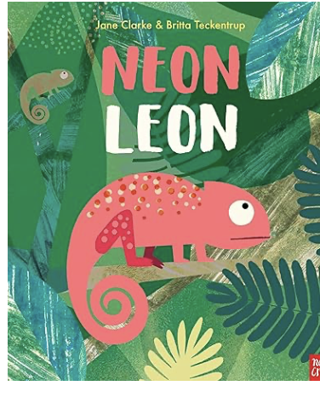
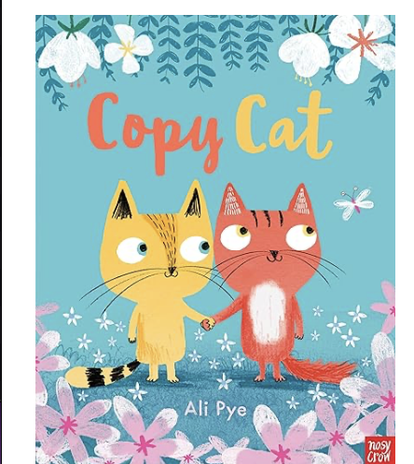
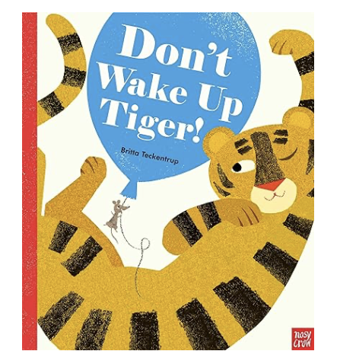
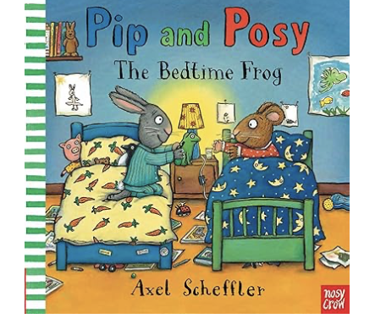
Areas of Learning
The focus this half term will be:
Literacy |  | Communication and Language | Maths
We will be exploring a range of books and stories this term from our NELI scheme, including Neon Leon, Pip and Posy and the bedtime frog, Don’t wake up Tiger and Copy Cat. This term the children will be learning to understand the 5 key concepts about print, engage in extended story conversations, write some or all of their name, write some letters accurately and develop phonological awareness. Vocabulary: word, letter, name, page, sentence, story, sound, rhyme, same, different, first sound, write, draw, mark, letter, line, curve. |  | This term we will be building on understanding two-part instructions such as ‘Put your coat on and sit on the carpet”. Using talk to organise play and thinking through modeling thinking aloud: “First I need the blocks, then I’ll build the wall”. We will engage in extended conversations about stories. Learn and use new vocabulary. The children will learn to respond to what they hear, sharing thoughts and feelings. Vocabulary: first, next, then, last, before, after, character, setting, beginning, middle, end, problem, solution, plan, decide, remember, explain, because, predict, excited, worried, proud, surprised, disappointed. | We will be developing our subitising skills, recognising objects without having to count them. The children will learn to know that the last number reached when counting a small set of objects tells you how many you have in total. We will be learning to link numerals to amounts. The children will use some positional language daily and make comparisons between objects using language such as more than and fewer than. Vocabulary: one, two, three, more, fewer, same, under, on top, behind, next to, between, bigger, smaller, taller, shorter, heavier, more than, fewer than.
Ideas to Support Learning at Home
Read every day—even short stories or picture books make a big difference. Talk to your child about the stories and characters, their likes and dislikes. Can they retell the story using the pictures? Encourage your child to spot letters from their name in the environment. Let them explore books freely—turning pages, talking about pictures. Provide paper and crayons for drawing and “writing” marks or scribbles. Visit the library together and talk about books they enjoy. |  | Talk to your child about what they did during the day—ask open-ended questions. Read stories together daily and talk about the characters and events. Sing nursery rhymes and songs to build rhythm and vocabulary. Play listening games like “Simon Says” or “I Spy.” Encourage your child to retell familiar stories using their own words. | Count everyday objects together (e.g., stairs, toys, fruit). Can your child recognise the amounts 1-3 without counting? Talk about shapes you see around the house (e.g., “That window is a square”). Play with sorting objects by colour, size, or shape. Use words like big/small, full/empty, more/less in everyday play. Sing number songs (e.g., “Five Little Ducks”, “Ten Green Bottles”).

Slide 3
Personal, Social and Emotional Development | Physical Development | Understanding the World | Expressive Arts and Design
This term we will be focusing on being confident within our class by confidently speaking to new adults and visitors in the setting. The children will try new experiences without adult reassurance such as joining shared group games and talking through worries about transitions. The children will also begin to recognise emotions in others and link emotions to characters. Vocabulary: Feelings (happy sad etc), share, take turns, join, help, kind, fair, gentle, feel, understand, care, worried, comfort. | We will have daily opportunities for gross motor skills including climbing, running and dancing. We will also have opportunities for fine motor control through play and activities such as threading, playdoh and mark making. The children may create their own dance routines and follow along with action songs. Through talk around self-care in Nursery the children will be encouraged to be independent to have self-care skills such as washing hands, toileting and dressing skills. Vocabulary: run, jump, hop, climb, push, pull, stretch, roll, cut, hand, foot, head, tummy, knee, back, pinch, grip, squeeze, press, control. | This term Nursery will be exploring the natural environment and to care and respect for living things. Children will be learning to recognise the wider world through talking about families, exploring food, clothes and music and exploring globes and maps. During our outdoor opportunities, the children will begin to explore seeds and plants, observing change in the seasons and the world around them. Through play the children will have role play experiences. Vocabulary:, seed, soil, root, stem, leaf, flower, grow, change, alive, dead, country, world, different, same, family. | Through Expressive art and design the children will be expected to draw with complexity and imagination, creating recognisble drawing with meaning and use talk around their drawings. There will be lots of open-ended creative play with paint, junk modelling and music. Within our role play area there is opportunities for the use of props and costumes for encouragement of imagination and using imagination through play using small world objects. Through our music lessons the children will be introduces to different music instruments, songs and movements. Vocabulary: line, shape, colour, detail, pattern, pretend, imagine, story, world, character, feel, think, like, enjoy, create.
Ideas to Support Learning at Home
Encourage your child to take turns and share toys at home. Talk about feelings using simple language (happy, sad, angry, excited). Let your child make small choices (e.g., “Do you want the red or blue cup?”). Support routines, such as tidying up toys or getting dressed independently. Praise efforts and build confidence with small responsibilities at home. | Visit the park to climb, run, and explore movement safely. Provide opportunities for mark-making: crayons, chalk, or paint at home. Practice fine motor skills with playdough, threading, puzzles, or blocks. Encourage your child to put on their coat and shoes independently. Support healthy habits like handwashing and trying new foods. | Explore the outdoors and talk about seasonal changes (e.g., falling leaves). Cook simple recipes together and talk about ingredients and changes. Talk about family traditions and special occasions. Let your child ask questions and explore “how” and “why” things work. Look at baby photos together and talk about how your child has grown. | Provide open-ended creative materials: paper, glue, recycled items, crayons. Sing and dance together to music at home. Encourage pretend play with dolls, toy animals, or kitchen sets. Let your child make up songs, dances, or stories using their imagination. Display their artwork proudly and talk about what they’ve made.

